Slide 1
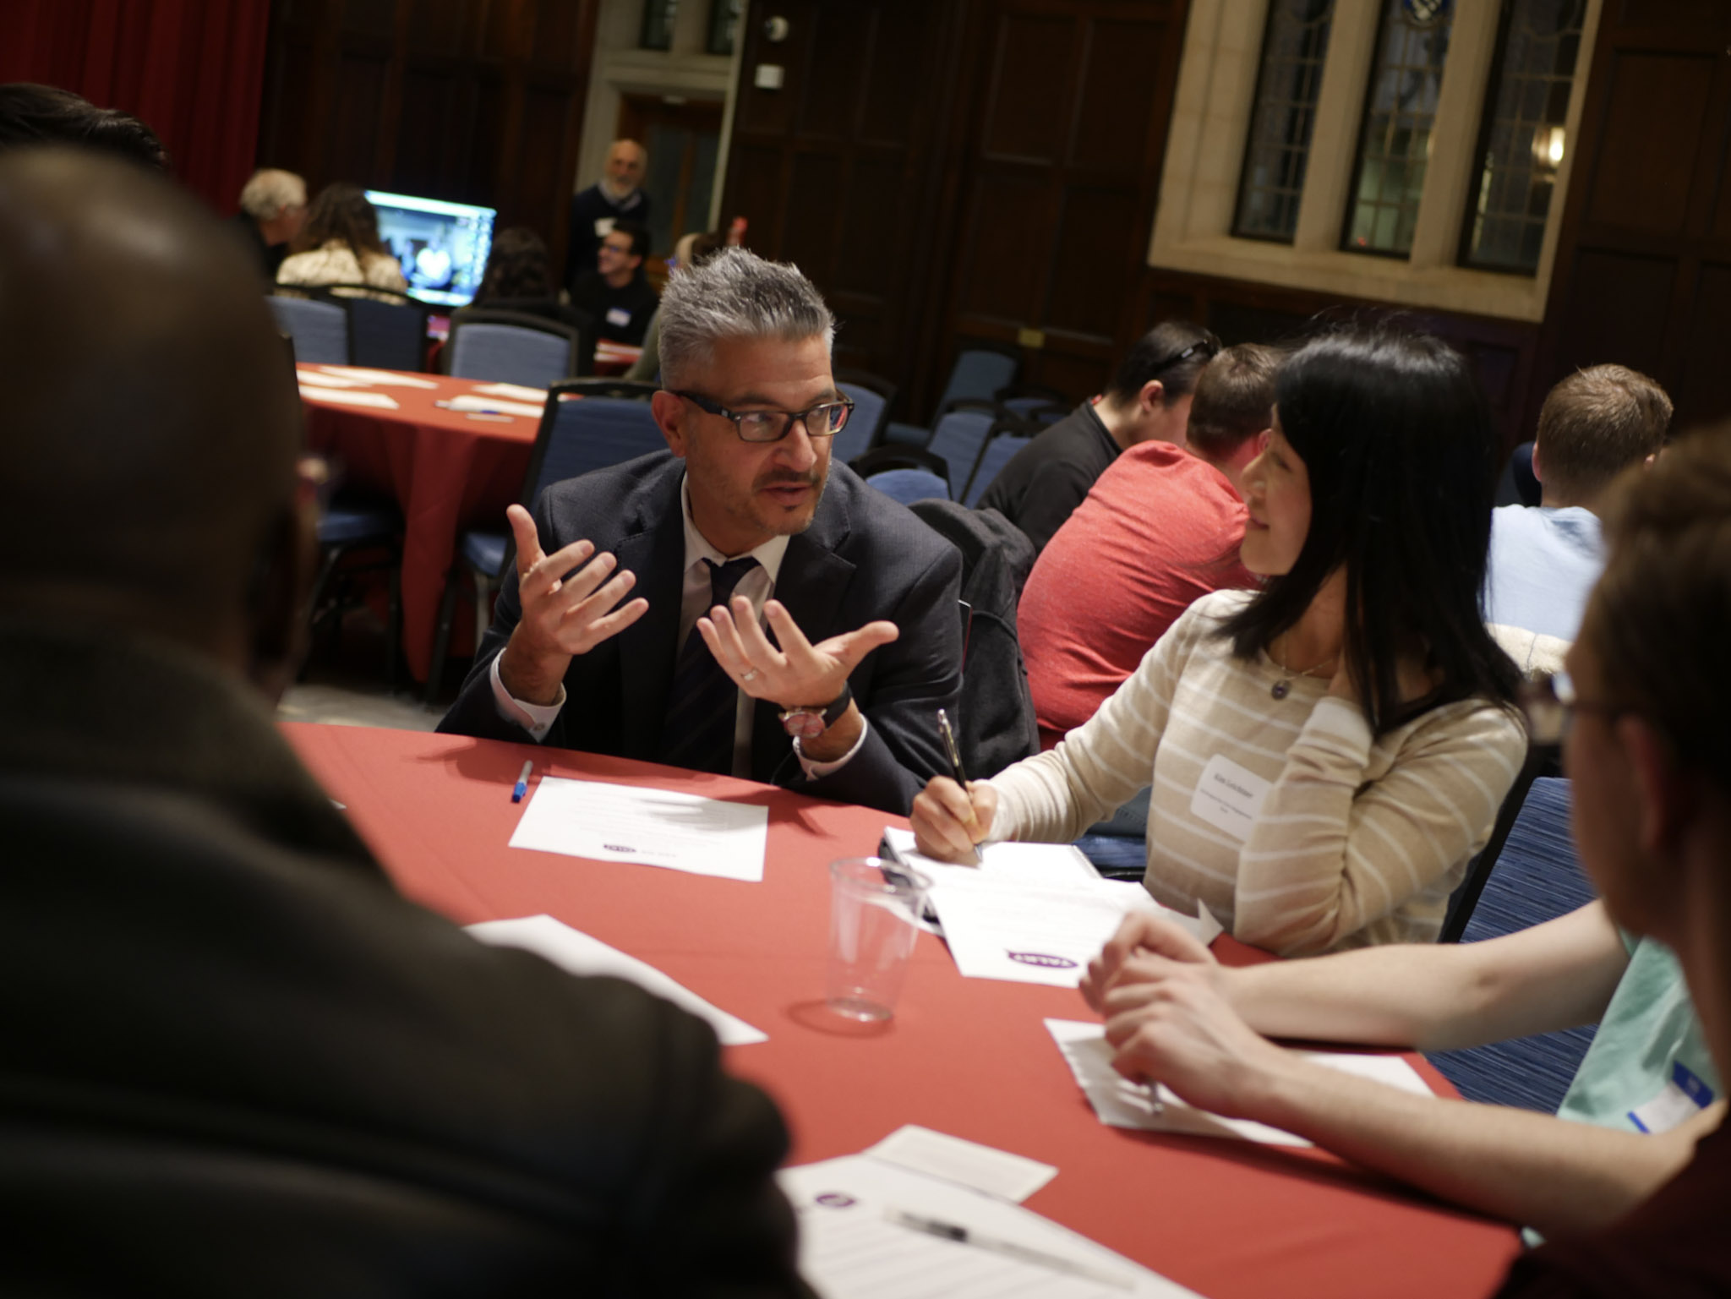
E pluribus unum? Lesson plan

Slide 2
QUESTION: HAVE YOU EVER REALLY LOOKED AT A U.S. QUARTER?

Slide 3
IN AN AGE WITH ALL OF THESE, PROBABLY NOT

Slide 4
BUT … LET’S TAKE A LOOK

Slide 5
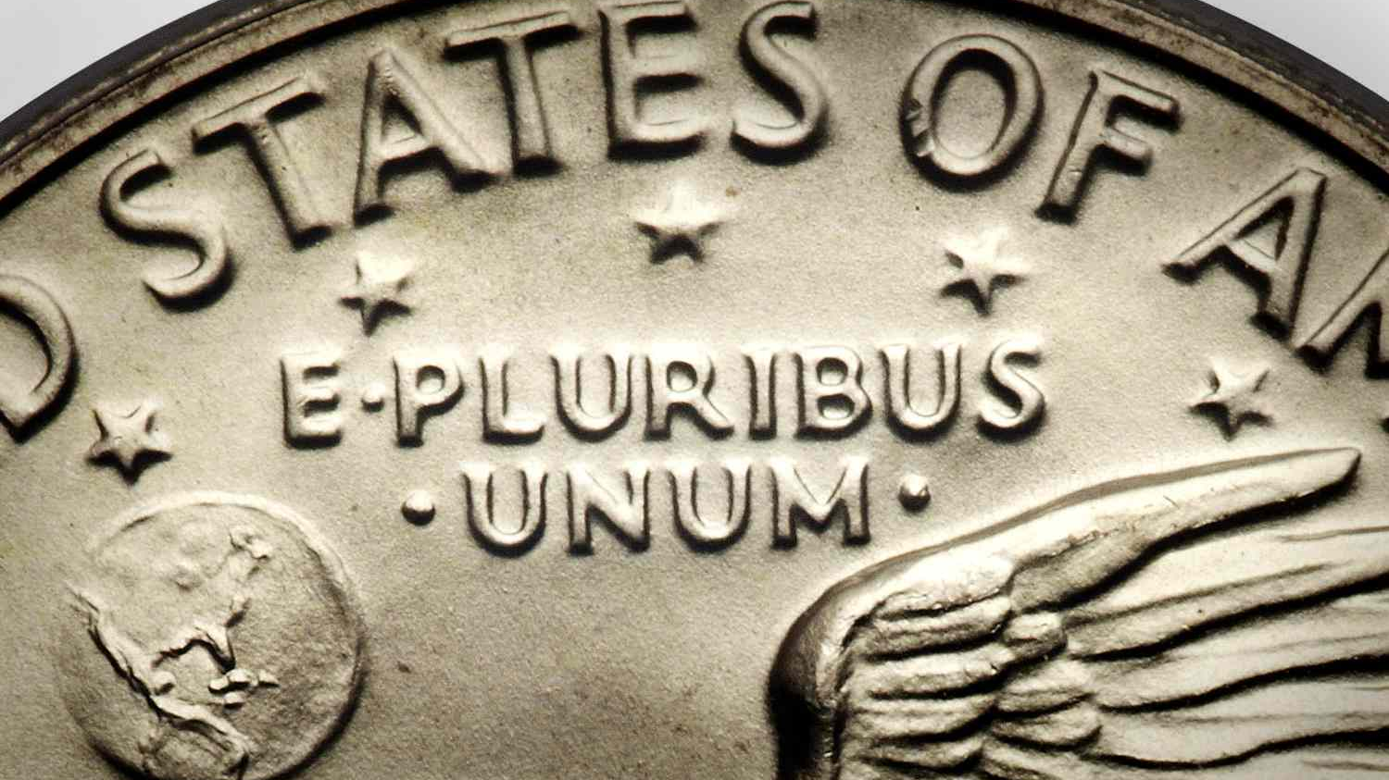
WHAT DOES this phrase MEAN?
Notes:
If possible, hand out traditional quarters to each student/each table and ask them to look them over, noticing the drawings and words on each side.
Then ask them to look on the side with the eagle and tell you what they see?
When someone mentions the phrase E Pluribus Unum, ask if anyone knows what language that is or what the words mean. As you do this, move to the next slide.
Once it’s established that it means “Out of Many, One,’ ask what do you think that phrase meant to the Founders; why did they think it so important that they put in on the new nation’s money?
Get a few comments from the group, then go to the next slide.

Slide 6
out of many, one WHAT DOES THAT MEAN?

Slide 7
More questions about the motto
WHAT OR WHO WERE INCLUDED IN THE ‘MANY’ BACK IN 1787?
HOW HAS THAT CHANGED TODAY?
AND WHAT IS THAT ‘ONE’ SUPPOSED TO BE AND DO?
Notes:
Moving to this slide, urge them to go deeper. What did they mean by ‘the many’ – what things or people were they referring to back in 1787. Then, ask them to think about America today: Who’s now included in the many who maybe weren’t part of the Founder’s ‘many’ back then – either because they hadn’t come to America yet, or because they were invisible and excluded.
Put the two lists up on a screen or board and ask the class to look at them side by side. Ask: “What do you notice?” The goal is to help them discover how much more diverse and robust today’s ’many’ is vs. the original notion. Ask them what that suggests to them about the arc of American history?
Finally, ask them: This ‘one’ that the many come together to form, what is it exactly? Be clear that there’s no single right answer - there are many answers that help to describe the ambitions of the American experiment.
Finally, whether the exact word comes up in the discussion or not, say there’s one word the founders used most often to describe what they thought the ‘one’ was – and go to the next slide.

Slide 8
A story (perhaps true) about ol’ Ben …
The story goes that …
aS BENJAMIN franklin emerged from independence hall at the end of the constitutional convention in 1787, a prominent Philadelphia woman called to him: “DR. Franklin, what have you given us, a monarchy or a republic?”
Notes:
You can ask at first whether anyone recognizes the person or the building depicted. Once you’ve defined that, read the words and ask the class what they think Franklin’s answer might have been. Then go to the next slide.

Slide 9
“A republic, Madam,” franklin replied, “if you can keep it.”
Notes:
You can ask: What do you think Franklin meant by “if you can keep it.”

Slide 10
A REPUBLIC. SO, WHAT IS THIS THING WE SAY PLEDGES TO?
Notes:
Grab as many answers to this as you can.

Slide 11
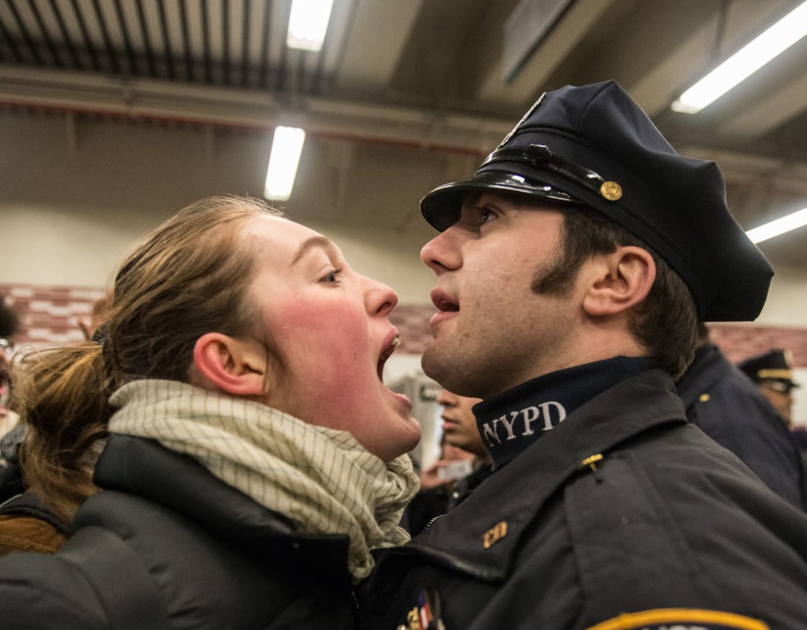
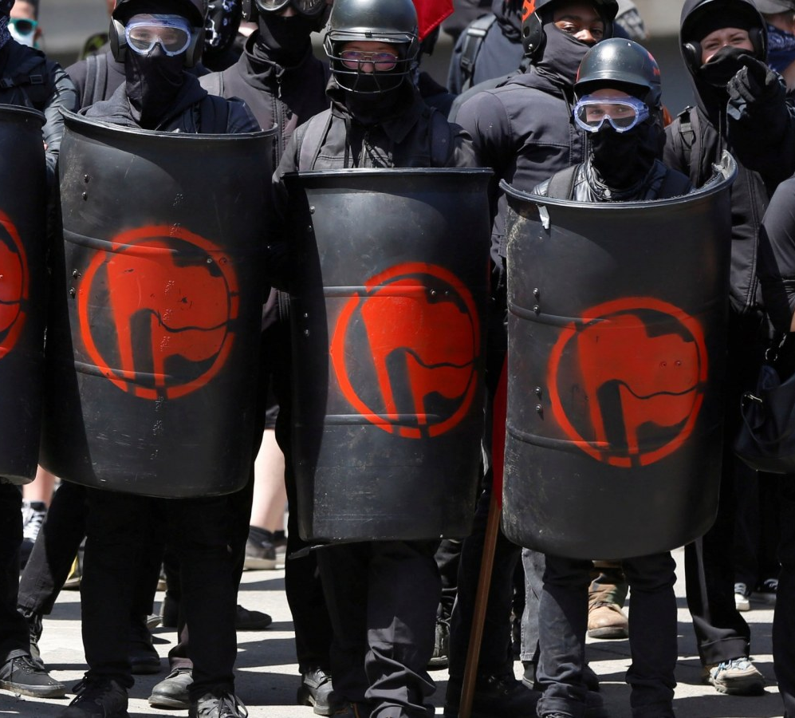
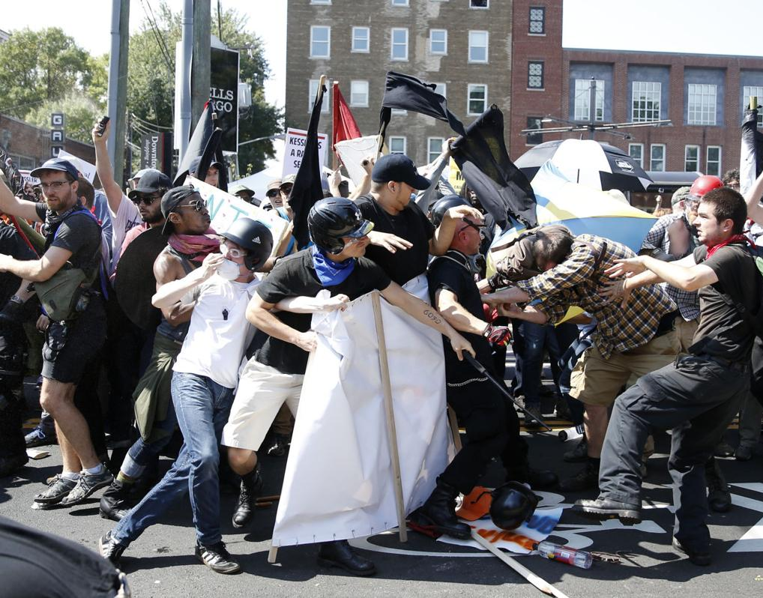
NEXT QUESTION: SO, ARE WE KEEPING IT?
DO YOU EVER WORRY THE ANSWER MIGHT BE NO?
Notes:
Say these are all scenes from recent events in America that suggest many of us feel angry and divided.

Slide 12
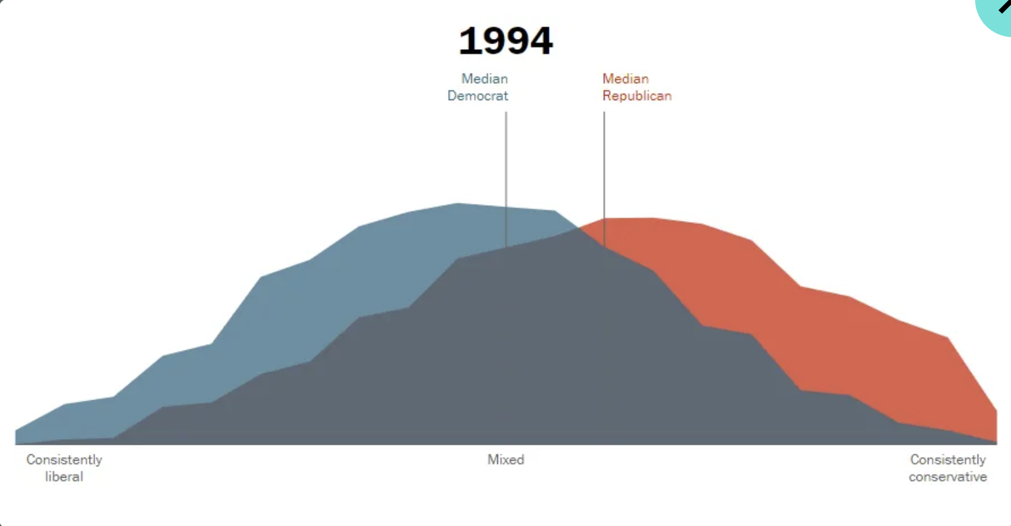
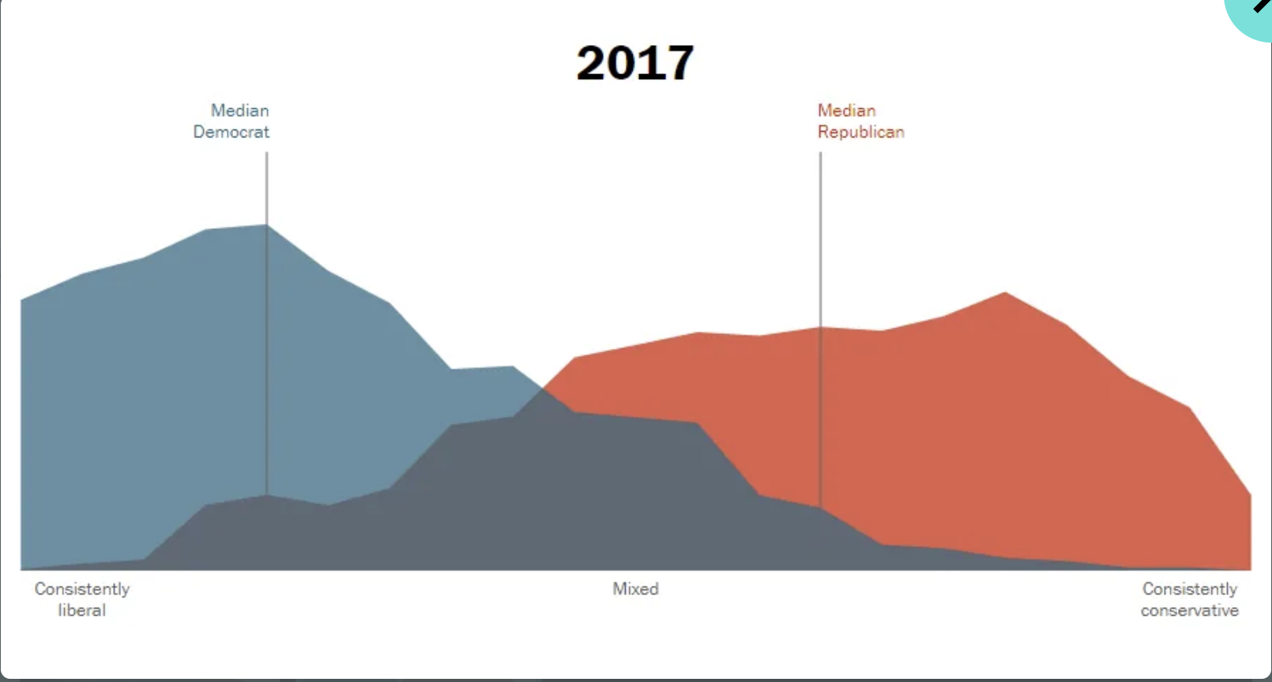
POLARIZATION: WHAT IS IT? WHERE DO YOU SEE IT?
https://www.pewresearch.org/politics/interactives/political-polarization-1994-2017/
Notes:
Explain that the way the mountains move apart here is a visual representation of America has become more divided, with a smaller “center”; and the movement has taken place pretty rapidly, in the time since their parents were in school (which seem like an eon to them, but is really a short period in history for such big changes)

Slide 13
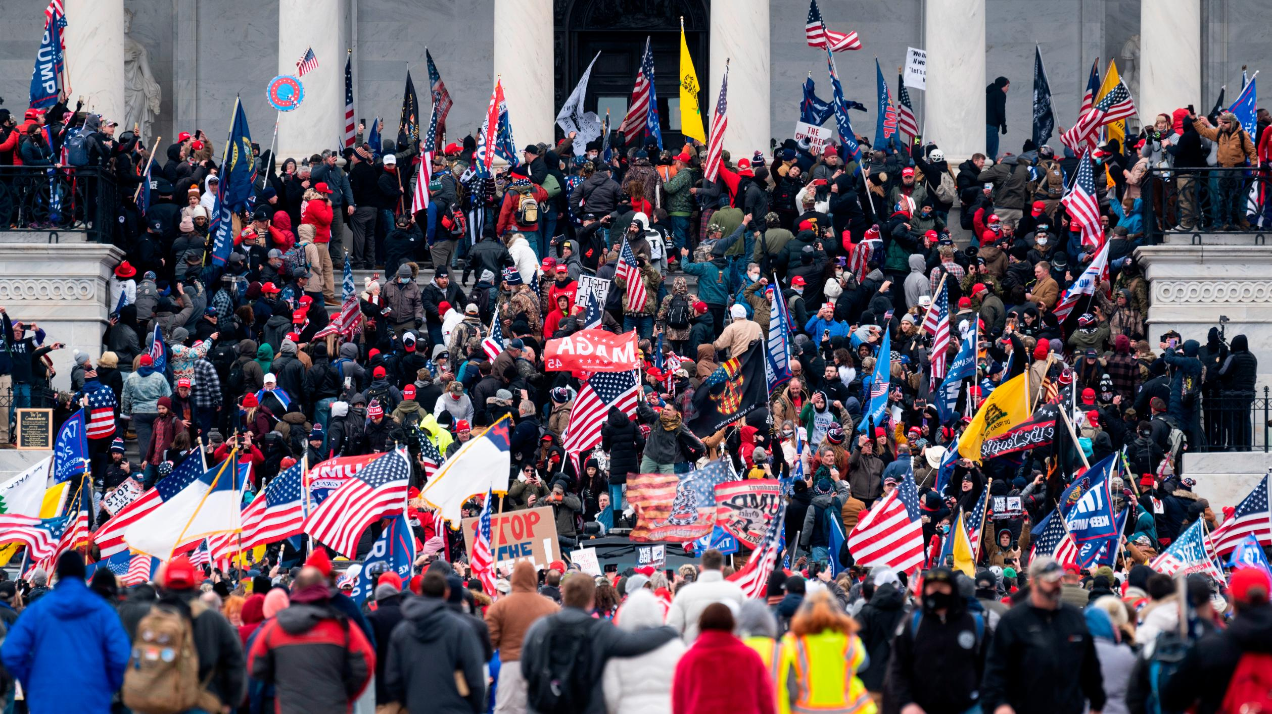
DISTRESSING NUMBERS FROM A DIVIDED NATION
POLARIZATION RANKED 3D (BEHIND ONLY INFLATION AND GUN VIOLENCE) AS A MAJOR ISSUE IN A 538/IPSOS POLL (2022) OF 1,700 AMERICANS
MORE THAN HALF OF YOUNG AMERICANS FEEL OUR DEMOCRACY IS ”IN TROUBLE” OR ”HAS FAILED.” MORE THAN A THIRD EXPECT A CIVIL WAR IN THEIR LIFETIMES. (HARVARD IOP POLL, 2021)
ONLY 4% OF MARRIAGES ARE BETWEEN D’S AND R’S; ONLY 21% ARE MIXED POLITICALLY IN ANY WAY (YOUGOV POLL)
HALF THE MEMBERS OF EACH PARTY THINK THE OTHER SIDE IS “IGNORANT”; 20% ON EACH SIDE THINK THE OTHER PARTY IS ACTIVELY “EVIL” (AXIOS POLL)
EACH SIDE OVERESTIMATES BY 2X THE % OF PEOPLE ON THE OTHER SIDE WHO HOLD “EXTREME” VIEWS (MORE IN COMMON STUDY)
Notes:
You can ask questions about any of the boxes with poll results, to see how the findings compare to their experiences or opinions. E.g. Does anyone here know that their parents or other relatives belong to different parties, and what’s that like. how do you family members handle that?.

Slide 14
WHAT DO YOU THINK? CAN WE STILL BE ‘OUT OF MANY, ONE’?
Notes:
Final discussion questsion

Slide 15
WHAT ABOUT YOU? AREN’T YOU ALSO ‘OUT OF MANY, ONE’?
‘I CONTAIN MULTITUDES’
Notes:
If there’s time, we’ve found it works well to have students pair up and do the Multiple Identities exercise, which is a separate exercise in the toolbox. (Again, you can ask if anyone knows who that photo is of … it’s Walt Whitman.)

